Slide 1

IGARSS 2024 Tutorial HD-12 Exploring Environmental Changes with ESA-NASA-JAXA EO Dashboard
M. Maskey (NASA), N. Sugita (JAXA), S. Sobue (JAXA), A. Anghelea (ESA)
R. Shinde (NASA), K. Kuroiwa (RESTEC), D. Moglioni (STARION), L. Dolezal (EOX)
eodashboard.org

Slide 2
Objectives
Learn about the EO Dashboard project
Learn how to use the EO Dashboard for:
Finding tri-agency data and scientific discoveries
Discovering computational resources made available by the tree agencies for research
Publishing new data (research outputs) to the dashboard
Communicating your research through storytelling
Education and Capacity building in EO

Slide 3
We hope you…
Learn something new
Explore using this platform for future
Meet new collaborator
Have a good time

Slide 4
Agenda
When |  | What | Who
09:00 – 09:05 |  | Welcome, setup, objectives, agenda | Manil Maskey (NASA)
09:05 – 09:15 |  | EO Dashboard project overview | Anca Anghelea (ESA)
09:15 – 09:30 | Hands-on | Follow-along EO Dashboard DEMO | Anca Anghelea (ESA)
09:30 – 10:00 |  | Accessing and working with EO Data from NASA, JAXA, ESA | Rajat Shinde (NASA) Kaori Kuroiwa (RESTEC for JAXA) Diego Moglioni (STARION for ESA)
10:00 – 10:15 |  | EO Dashboard STAC Catalogue | Lubomir Dolezal (EOX)
10:15 – 10:30 |  | Break for coffee
10:30 – 10:45 | Hands-on | Storytelling Tool DEMO | Diego Moglioni (STARION for ESA) Lubomir Dolezal (EOX)
10:45 – 11:45 | Hands-on | Creating and publishing a story with EO Dashboard | Anca Anghelea (ESA) Rajat Shinde (NASA) Kaori Kuroiwa (RESTEC for JAXA) Diego Moglioni (STARION for ESA) Lubomir Dolezal (EOX)
11:45 – 11:55 |  | Become a contributor to EO Dashboard | Anca Anghelea (ESA) Lubomir Dolezal (EOX)
11:55 – 12:00 |  | Closing | Manil Maskey (NASA)

Slide 5
EO Dashboard Project Overview

Slide 6
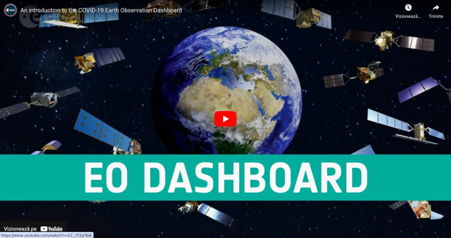

Tri-agency collaboration
Started in 2020 as a collaboration to to monitor the worldwide impacts of COVID-19
Released with joint press release in June 2020
Expanded in scope in 2022 to cover 6 additional thematic areas, focusing on environmental change:
Atmosphere
Agriculture
Cryosphere
Oceans (and Inland water)
Biomass
Economy
EODashboard.org
This video includes interviews of:
Thomas Zurbuchen: Associate Administrator for NASA’s Science Mission Directorate
Josef Aschbacher: ESA’s Director of Earth Observation Programmes
Koji Terada: Director General Space Technology Directorate, JAXA

Slide 7
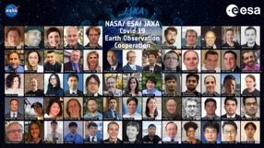

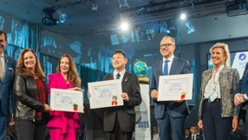

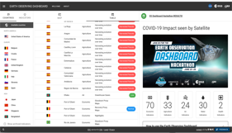
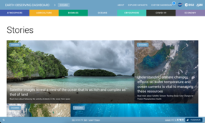
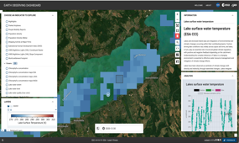
Important Milestones
509 Teams
4.337 participants
132 countries
IAF Award “Space for Climate Protection”
Open for Community Contributions
Storytelling
6 new themes
Scrollytelling
STAC Catalogue
New UI/UX
Global presence
2020 -2021
2021 - 2022
2022 - 2023
2023 - 2024

Slide 8


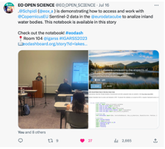





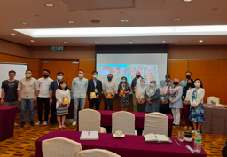


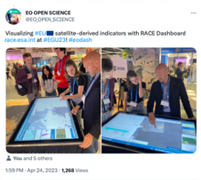
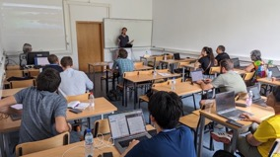
Open Science and Community Engagement
Our principles:
Open science
Involvement of domain experts
Continuous evaluation of impact/values - benefits are multifaceted
Inclusion of multi-party stakeholders
Aim for transparency - encourage participation

Slide 9
Tri-Agency Mission Data
 | NASA | ESA | JAXA | Global Datasets
Atmosphere | OMI, OCO-2, OMPS, AIRS, IASI, CrIS, MOPITT | Sentinel-5p TROPOMI | GOSAT/GOSAT-2 | CO2 daily, CO2 daily difference, CO, SO2, CH4, NO2 daily, NO2 monthly, NO2 yearly
Biomass and Land | MAAP | Sentinel-1, CCI biomass | GCOM-C, ALOS-2 | NDVI, Forest-non-forest map, above ground biomass
Oceans and Water | MODIS, VIIRS, | Sentinel-2, Sentinel-3, CCI Lakes | GCOM-C | Lakes water quality, true colour, lake turbidity, ocean primary productivity
Economy | SkySat, PlanetScope, VIIRS, Landsat-8 | Sentinel-1, Sentinel-2 | ALOS-2 | Built Up areas, global gridded relative deprivation indices (several), population densities
Agriculture | GPM, Landsat-8, SMAP, MODIS, SGLI, | Sentinel-1, Sentinel-2, Sentinel-5p, SMOS | GPM, GCOM-C, GCOM-W ALOS-2 | Crop area and crop conditions, NDVI, Agromet information (Precipitation, Precipitation anomaly, soil moisture, soil moisture anomaly, LST, LST anomaly)
Cryosphere | IceSat-2, MODIS | Cryosat-2, Envisat ASAR, Sentinel-1, Sentinel-2 | GCOM-W | Antarctica melt duration, onset and season end, Antarctica melt maps, Arctic Sea Ice concentration, Antarctic Sea Ice concentration, Sea Ice thickness, West Antarctica glaciers

Slide 10
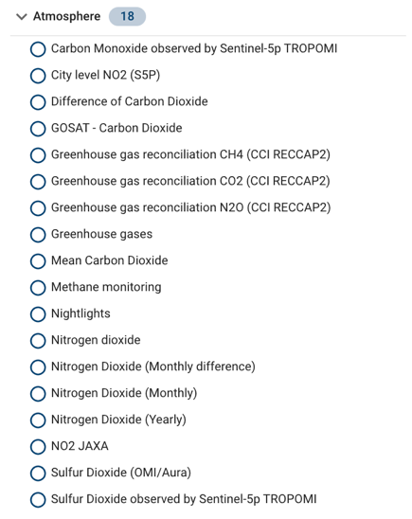

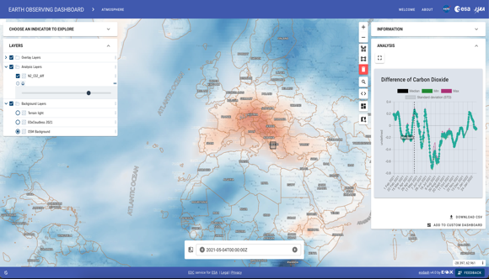
Example datasets
Data discovery – by theme, mission, instrument, etc.
Time series exploration, simple analytics

Slide 11




Contributing Activities
EO Dashboard is supported by the three agencies via several activities
Each agency contributes with:
EO Data and EO Science
In-kind expertise (scientific analyses, communication)
Infrastructure and technology: NASA’s VEDA, ESA’s Euro Data Cube, JAXA’s Earth-graphy
Through the Open Science Persistent Demonstrator ESA and NASA sponsored pilots to further open-source development by the community to enhance EO Dashboard visualization and information exchange

Slide 12
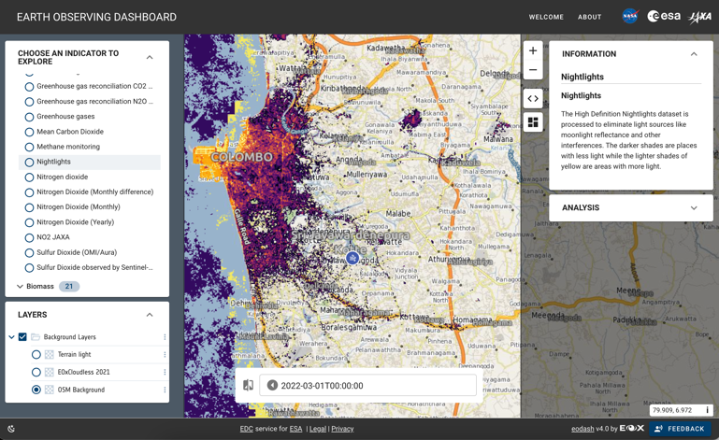
Scientific Communication and Education
Use the dashboards as educational resource
possibility to get custom data or workflows onboarded to illustrate scientific concepts

Slide 13
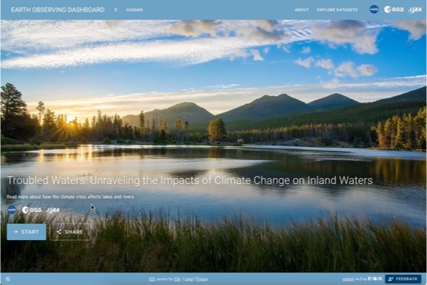
Scientific Communication and Education
Use the dashboards as educational resource
possibility to get custom data or workflows onboarded to illustrate scientific concepts
Publish your research on the dashboards
Publish an experiment (fully or partially), host your dataset, etc.

Slide 14

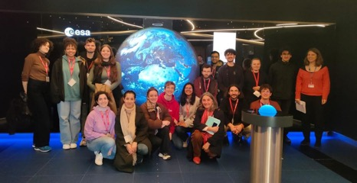

Scientific Communication and Education
Use the dashboards as educational resource
possibility to get custom data or workflows onboarded to illustrate scientific concepts
Publish your research on the dashboards
Publish an experiment (fully or partially), host your dataset, etc.
Contribute a story on a societally relevant topic that can be illustrated with EO
Details on the Science Hub website: https://sciencehub.esa.int/

Slide 15
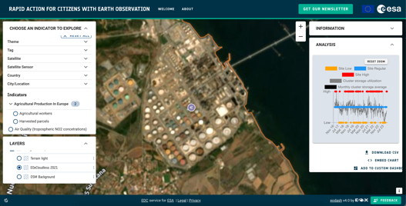

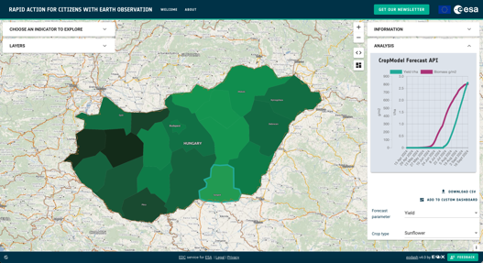
Developed with industry
Visualisation services
Data hosting and provisioning
Algorithm hosting and execution
Co-developing other components for dashboard evolution
OILX Crude Oil Index API
Engaging with the FOSS Community at FOSS4G
CropOM Crop Model API

Slide 16
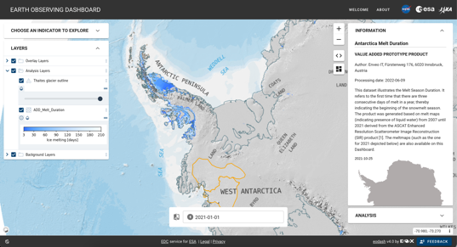
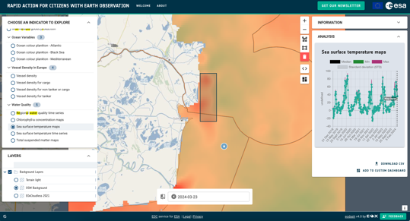
Disseminating novel research
Promote research results
Use the Dashboards as a dissemination tool for data and methods
Reach communities
Communicate R&D outcomes to wider audiences
Maximise the use of the data, test out ideas, verify outcomes, etc.
Organise a Dashboard challenge with your data
ENVEO Antarctitca Melt Maps Prototype Product
CNR ISMAR Sea Surface Temperature

Slide 17
Setup
Checklist:
Internet Access
Access to VEDA
Access to Euro Data Cube
Sign the presence sheet

Slide 18
Forests Story ESA RECCAP-2 datasets

Slide 19
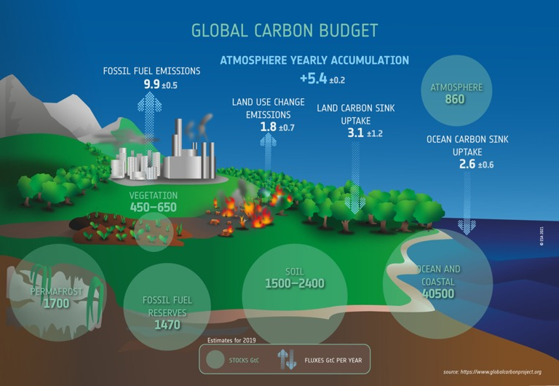
Global Carbon Budget
Fundamental to understanding the global carbon cycle is accurate knowledge of how much carbon is stored in the atmosphere, ocean and terrestrial biosphere – the carbon stocks and the rate of flow, or fluxes, between these stocks.
Forest biomass represents a proxy for stored carbon.
Current estimates of total emissions taken up:
By land: 28%
By the oceans: 22%
But there are large uncertainties in these values, especially the land uptake.
The LUC flux (difference between emissions from forest loss and uptake of carbon dioxide by forest regrowth), has an uncertainty of about 54%.
Notes:
The Paris Agreement adopted a target for global warming not to exceed 1.5°C. This sets a limit on the additional carbon we can add to the atmosphere – the carbon budget. Only around 17% of the carbon budget is now left. That is about 10 years at current emission rates.
But there is sufficient uncertainty (indicated by the +- signs in the graphic on the right) across all the components of the carbon cycle that there is a small probability we have no remaining carbon budget. This means that even if emissions were to go to zero today, warming would still exceed 1.5°C.
Fundamental to understanding the global carbon cycle is accurate knowledge of how much carbon is stored in the atmosphere, ocean and terrestrial biosphere – the carbon stocks and the rate of flow, or fluxes, between these stocks.

Slide 20
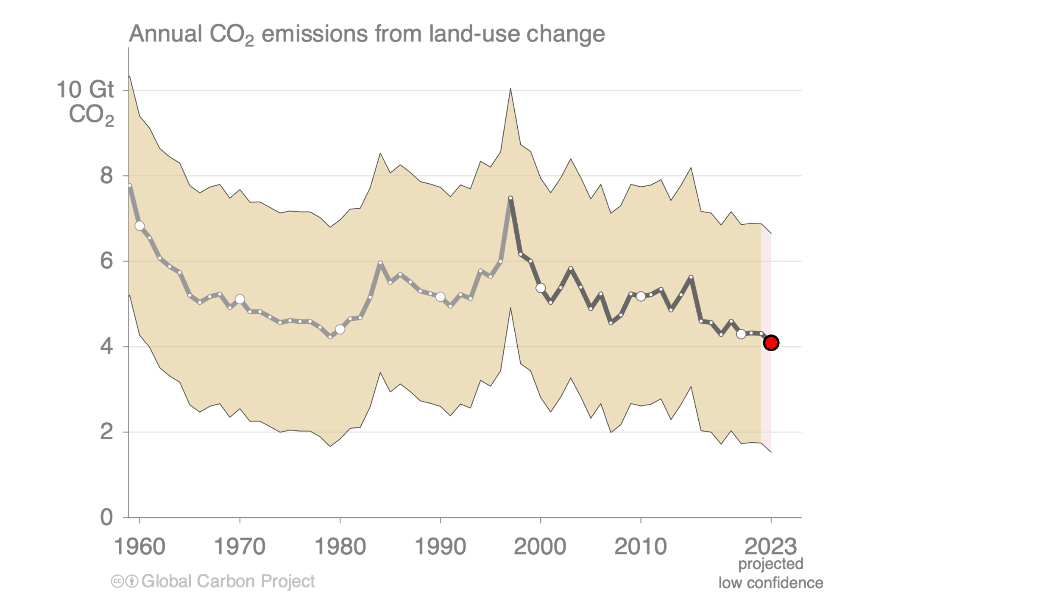
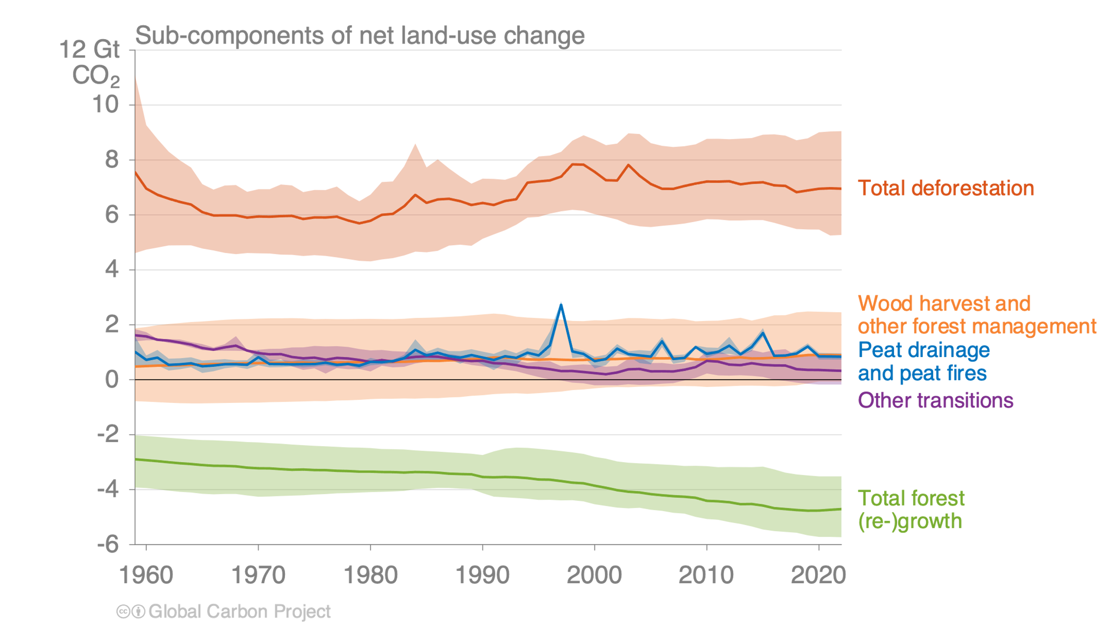
Land-use change emissions
Land-use change emissions are 4.7 ± 2.6 GtCO₂ per year for 2013–2022, and show a negative trend in the last two decades, but estimates are still highly uncertain.
Net land use emissions are the result of multiple anthropogenic activities on land that lead to CO₂ emissions or removals
Indonesian fires
Projection for 2023:
4.1 ± 2.6 GtCO₂
Estimates from three bookkeeping models Source: Friedlingstein et al 2023; Global Carbon Project 2023
Slide Source: https://globalcarbonbudget.org/carbonbudget2023/

Slide 21
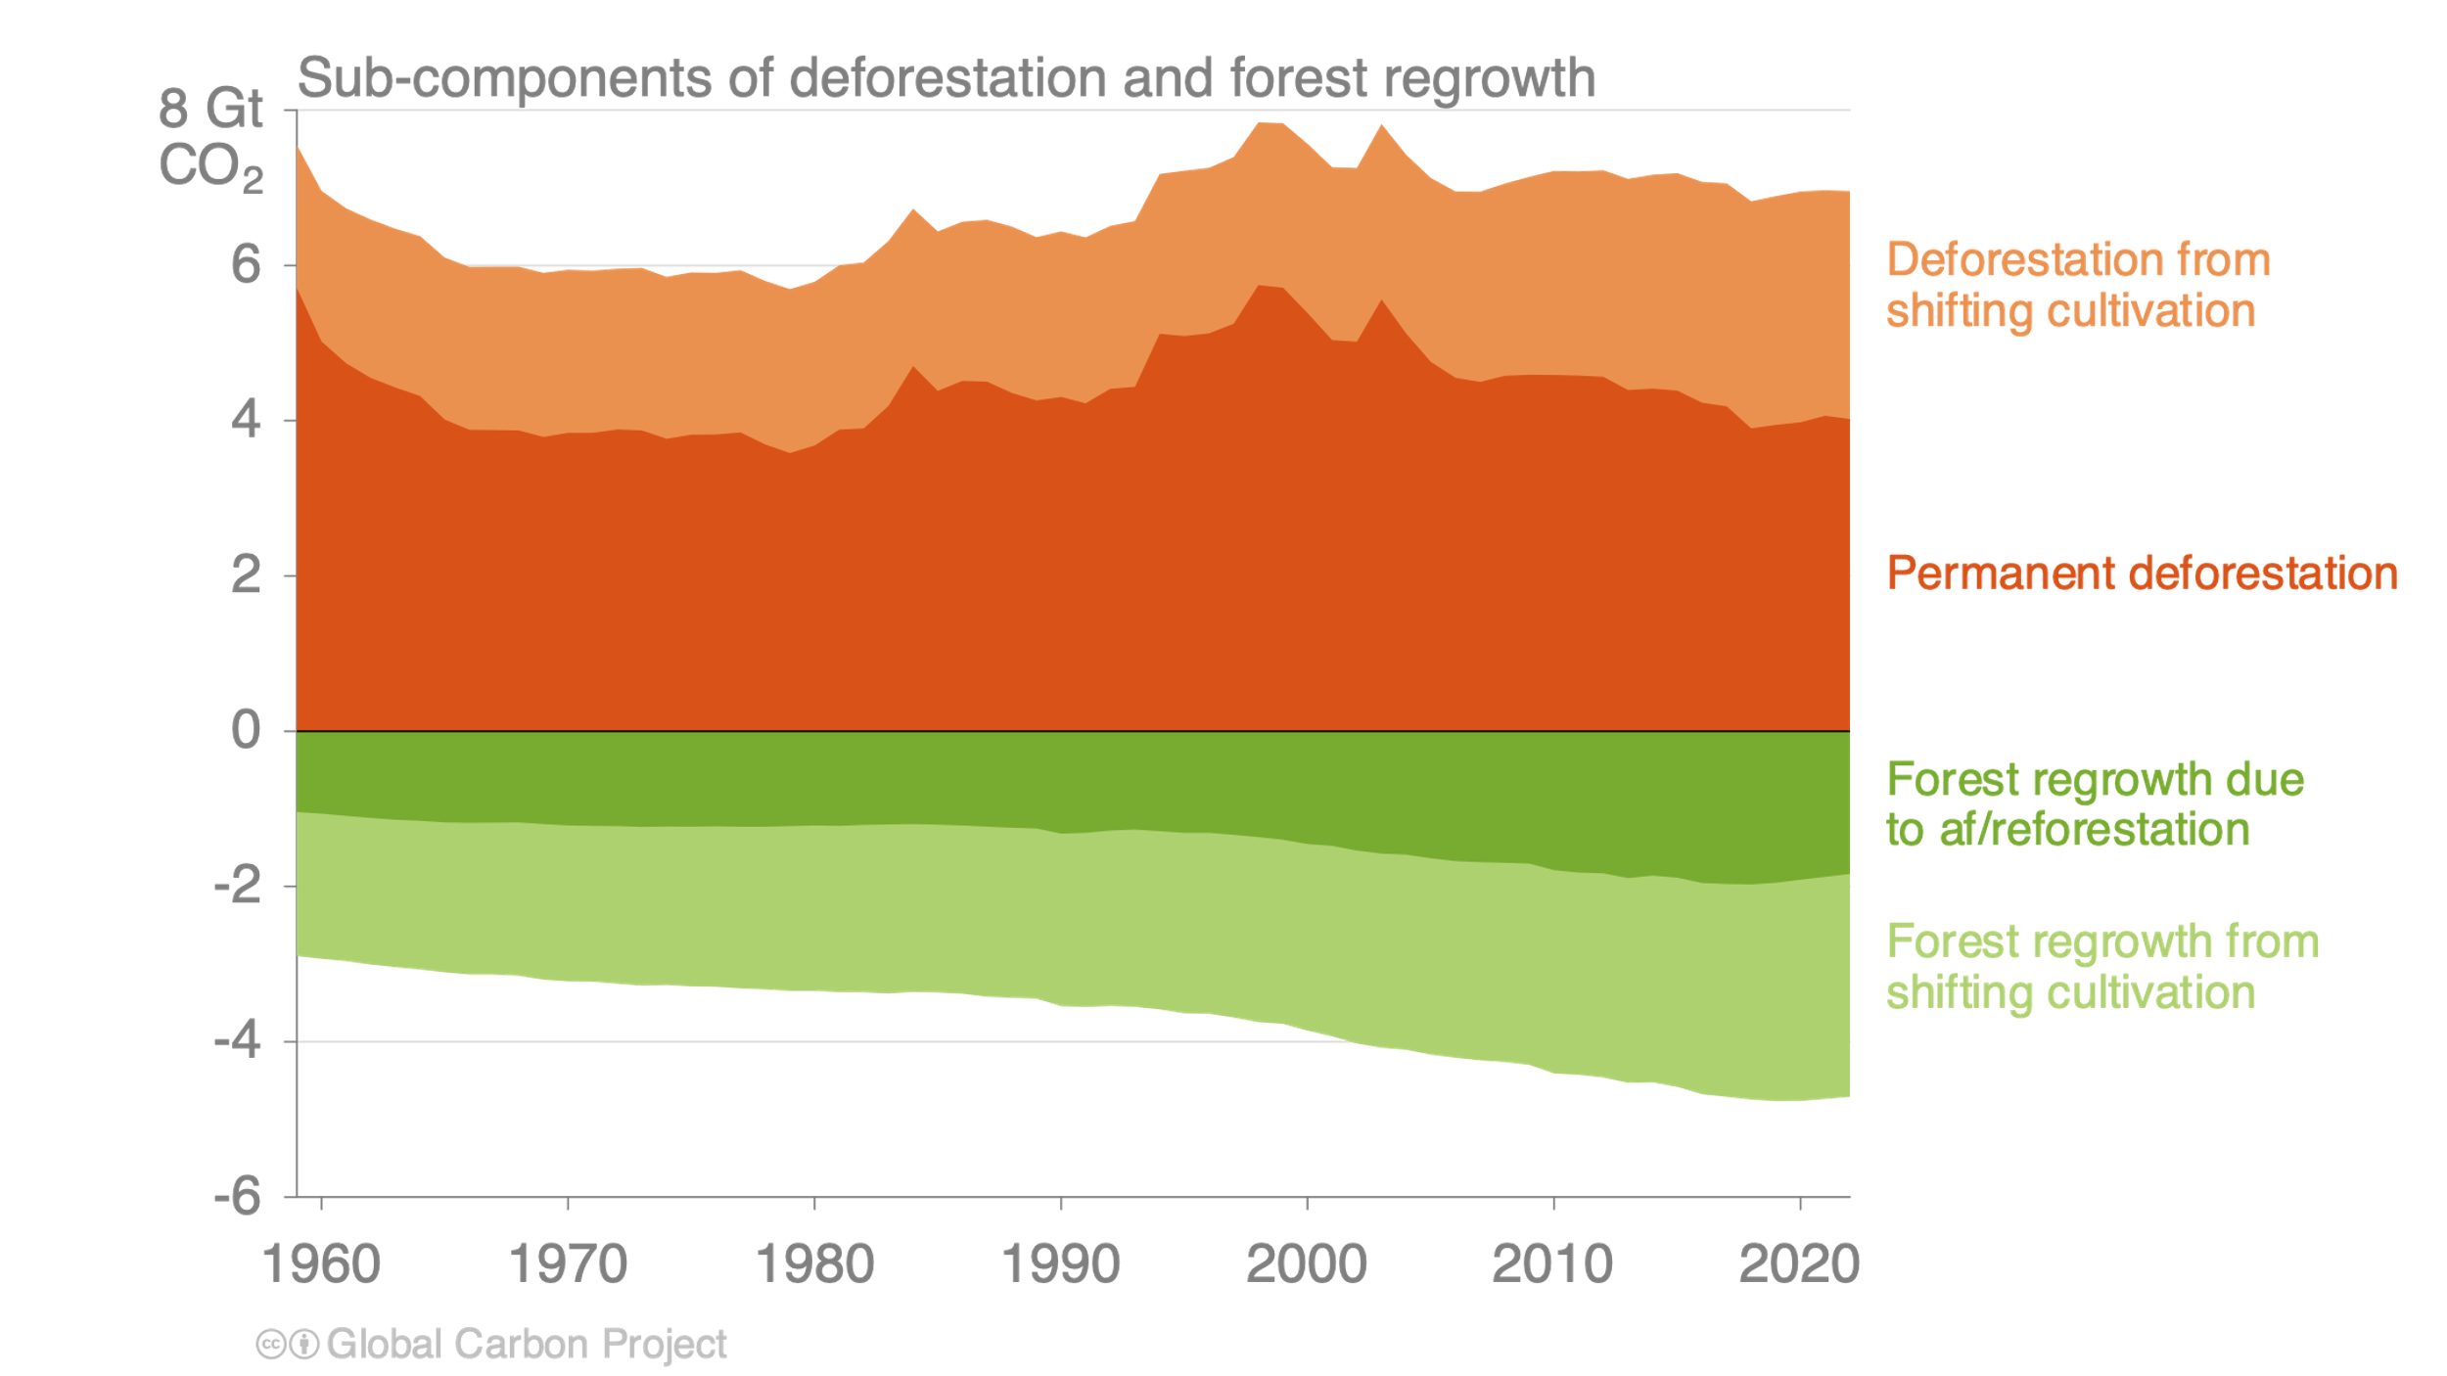
Land-use change emissions
Emissions from permanent deforestation are 4.2 GtCO₂ per year for 2013–2022.
Carbon dioxide removals through permanent af/reforestation are 1.9 GtCO₂ per year over the same period.
Estimates from three bookkeeping models Source: Friedlingstein et al 2023; Global Carbon Project 2023
Slide Source: https://globalcarbonbudget.org/carbonbudget2023/

Slide 22
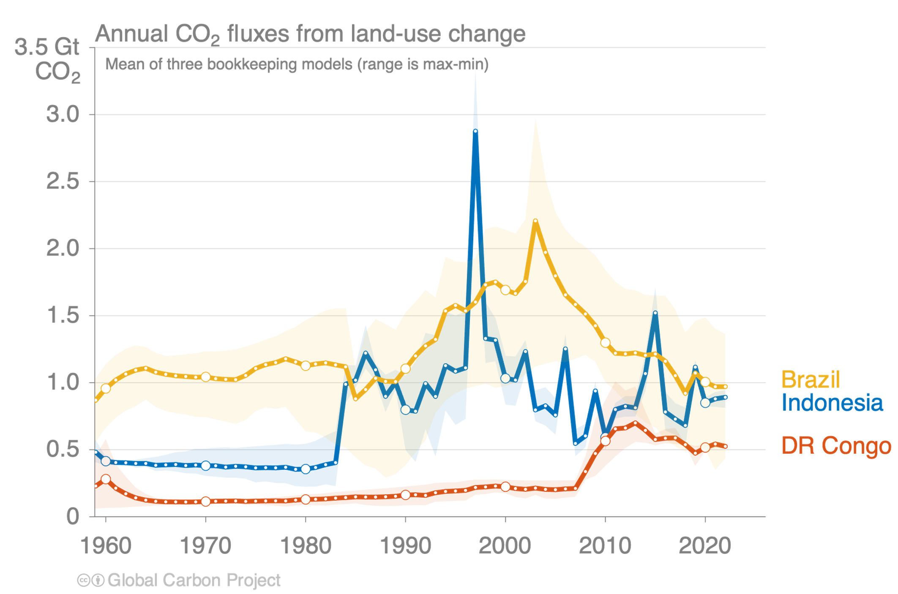
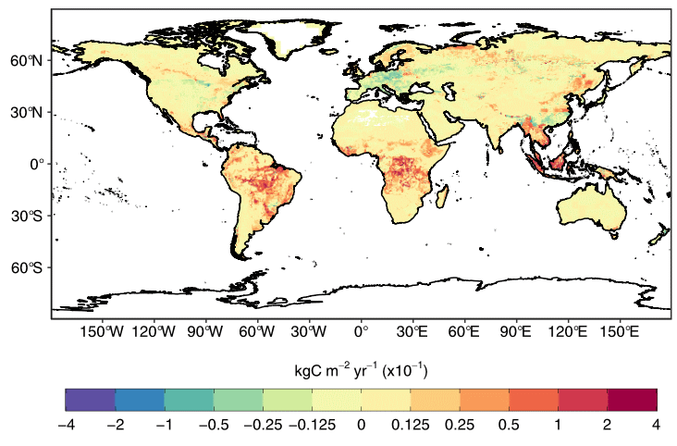
Regional patterns of land-use change emissions
The top three emitters over 2013–2022 – Brazil, Indonesia, and the Democratic Republic of the Congo – contribute 55% of the global net land-use emissions.
Land-use emissions are high in the tropics, driven largely by deforestation. Net sinks occur in regions of re/afforestation such as parts of Europe and China.
Land-use emissions, decadal average 2013–2022
Estimates from three bookkeeping models Source: Friedlingstein et al 2023; Global Carbon Project 2023
Slide Source: https://globalcarbonbudget.org/carbonbudget2023/
The peak in Indonesia in 1997 was the Indonesian peat fires.

Slide 23
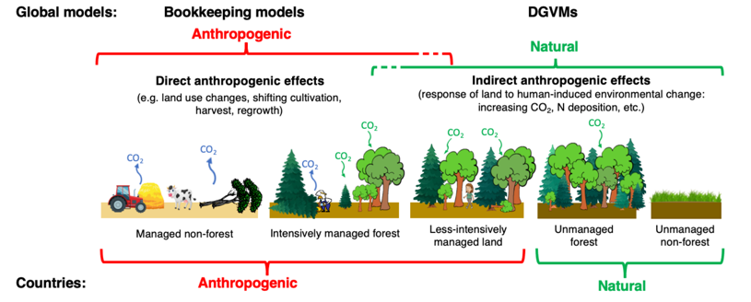
Linking global models to country reports
Mapping of global carbon cycle model land flux definitions to the definition of the LULUCF net flux used in national Greenhouse Gas Inventories (NGHGI) reported to UNFCCC
When natural fluxes on managed forests (-7.5 GtCO₂ per year for 2013–2022) are added to land-use emissions (4.7 GtCO₂ per year), the GCB2023 estimates (-2.1 GtCO₂ per year) are very similar to the country-reported data (-2.0 GtCO₂ per year), linking the anthropogenic carbon budget estimates of land CO₂ fluxes directly to the Global Stocktake as part of UNFCCC Paris Agreement.
Source: Friedlingstein et al 2023; Global Carbon Project 2023
Figure from Grassi et al., ESSD 2023
Slide Source: https://globalcarbonbudget.org/carbonbudget2023/
Notes:
There is an increasing demand for scientific support on climate-related decisions, in particular for providing societies and policy-makers with reliable and up-to-date information about atmospheric greenhouse gas (GHG) emissions and natural sinks. The Global Carbon Project now reports annually on the evolution of global CO2 sources and sinks, their uncertainties and the resulting Global Carbon Budget, in phase with the United Nations Framework Convention on Climate Change (UNFCCC) annual Conference of the Parties (COP).

Slide 24
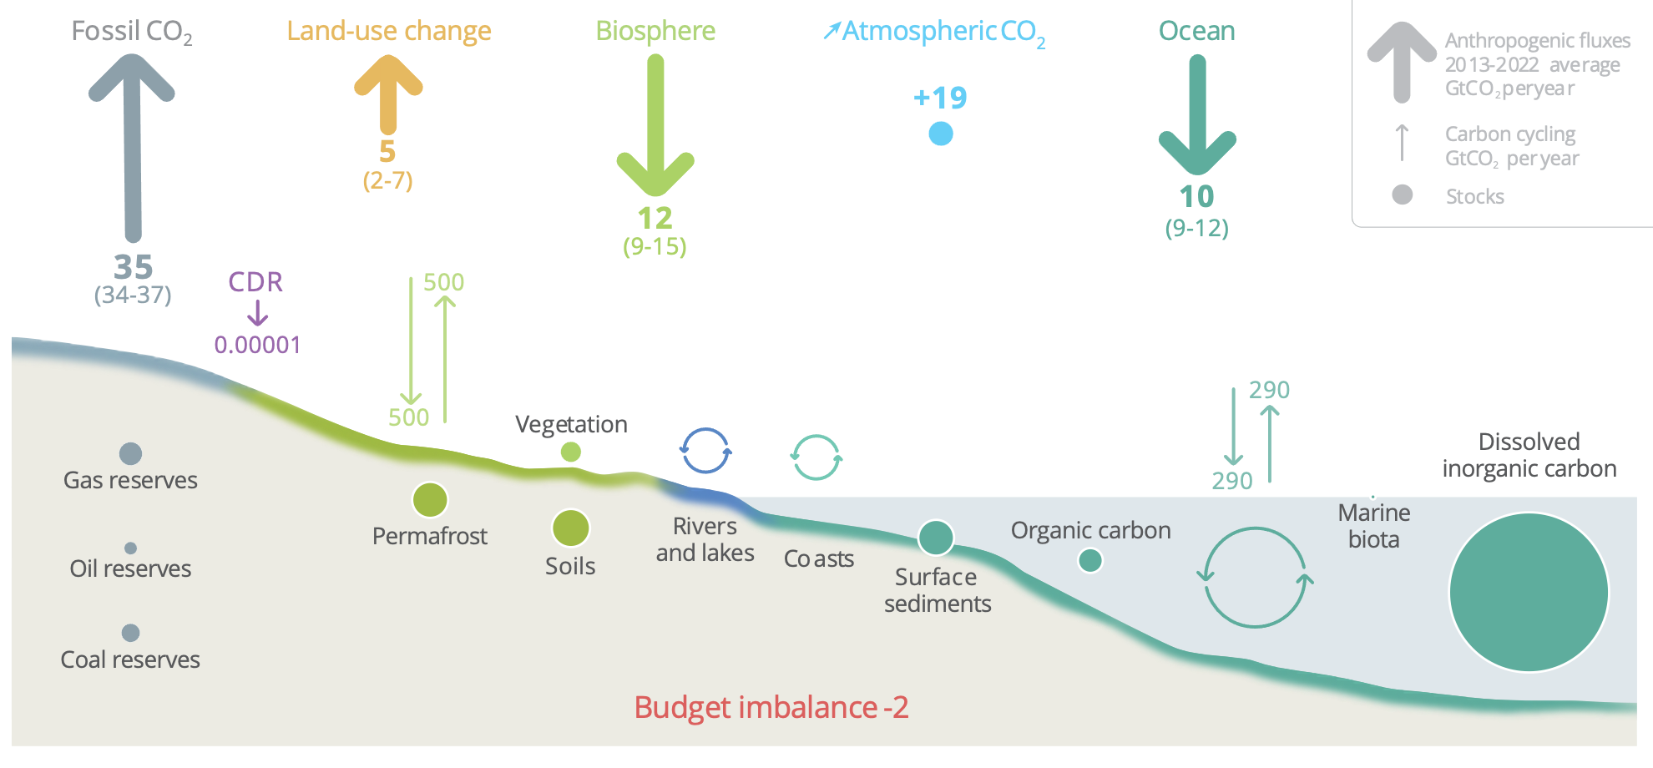
Anthropogenic perturbation of the global carbon cycle
Perturbation of the global carbon cycle caused by anthropogenic activities, global annual average for the decade 2013–2022 (GtCO₂/yr)
CDR here refers to Carbon Dioxide Removal besides those associated with land-use that are accounted for in the Land-use change estimate. The budget imbalance is the difference between the estimated emissions and sinks. Source: NOAA-GML; Friedlingstein et al 2023; Canadell et al 2021 (IPCC AR6 WG1 Chapter 5); Global Carbon Project 2023
Source: https://globalcarbonbudget.org/carbonbudget2023/
Notes:
Global stocktaking, as defined by the Paris Agreement, further requires information about national GHG budgets that should be consistent with the global budgets and regularly updated. Still, the latest global carbon budget (Friedlingstein et al., 2019, ESSD) estimates a budget imbalance (knowledge-gap) of ca. 0.4 PgC (Figure). Top-down and bottom-up estimates also show important discrepancies over different latitudinal bands and a non-negligible fraction of the global carbon budget variability remains to be captured by land and ocean models. This underscores the need for regional studies to better use EO data and constrain key processes/regions in the global C-cycle.

Slide 25
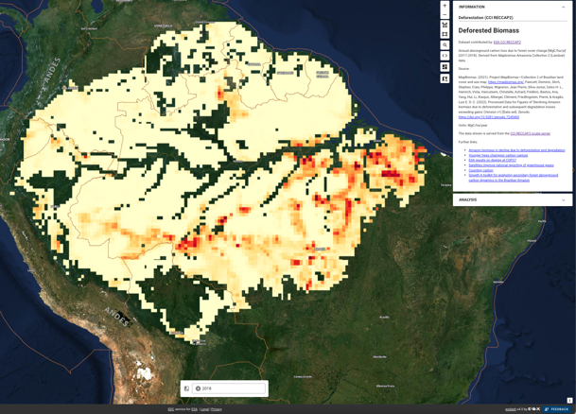
ESA CCI RECCAP-2
REgional Carbon Cycle Assessment and Processes, Phase 2 (RECCAP-2)
Coordinated by the Global Carbon Project
Collect and synthesize regional data for 14 large regions of the globe
Harmonization sufficient to be able to scale these budgets to the globe and to compare different regions.
Annual aboveground carbon loss due to forest cover change [MgC/ha/yr] (2011-2018).
Derived from Mapbiomas Amazonia Collection 2 (Landsat) data.
Reference: MapBiomas. (2021). Project MapBiomas—Collection 2 of Brazilian land cover and use map. https://mapbiomas.org/, Fawcett, Dominic, Sitch, Stephen, Ciais, Philippe, Wigneron, Jean Pierre, Silva-Junior, Celso H. L., Heinrich, Viola, Vancutsem, Christelle, Achard, Frédéric, Bastos, Ana, Yang, Hui, Li, Xiaojun, Albergel, Clément, Friedlingstein, Pierre, & Aragão, Luiz E. O. C. (2022). Processed Data for Figures of 'Declining Amazon biomass due to deforestation and subsequent degradation losses exceeding gains' (Version v1) [Data set]. Zenodo. https://doi.org/10.5281/zenodo.7245450
Explore this dataset
https://www.eodashboard.org/explore?indicator=RECCAP2_6&x=-6755912.34154&y=-638592.47499&z=5.86884
Notes:
The aims of the international initiative ‘REgional Carbon Cycle Assessment and Processes’, Phase 2 (RECCAP-2) coordinated by the Global Carbon Project are to collect and synthesize regional data for 14 large regions of the globe with a requirement of harmonization sufficient to be able to scale these budgets to the globe and to compare different regions. Key policy-relevant challenges for the scientific community and objectives of the RECCAP-2 project are to:
The ESA-CCI project RECCAP-2 plays a crucial role in supporting and accelerating the analysis of regional carbon budgets. It achieves this by leveraging data-driven models and process-oriented Global Dynamic Vegetation Models used by the Global Carbon Project. Specifically, RECCAP-2 operationalizes the production and uncertainty assessment of regional CO2 budgets. It takes stock of newly available land surface and atmospheric remote sensing data to constrain and improve model results¹. The project aims to:
Improve quantification of anthropogenic greenhouse gas emissions and their sources.
Develop robust observation-based estimates of changes in carbon storage and greenhouse gas emissions and sinks by oceans and terrestrial ecosystems, distinguishing anthropogenic vs. natural fluxes and their driving processes

Slide 26
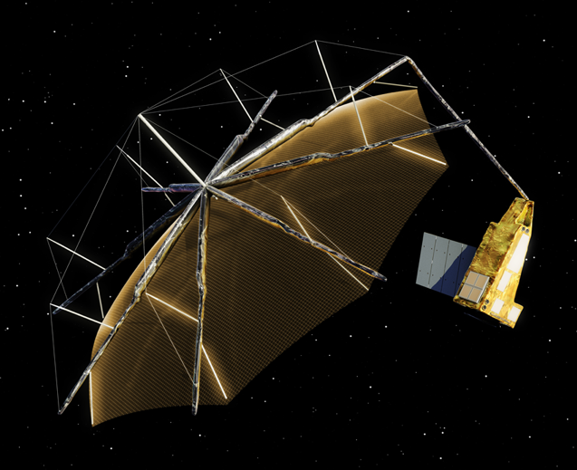
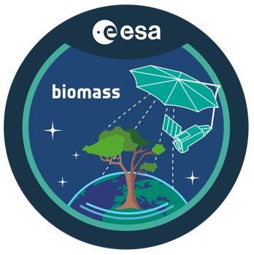
ESA Biomass Mission
ESA’s 7th Earth Explorer to be deployed in 2025
An interferometric, polarimetric P-band SAR
Designed to observe forest height and biomass

Slide 27
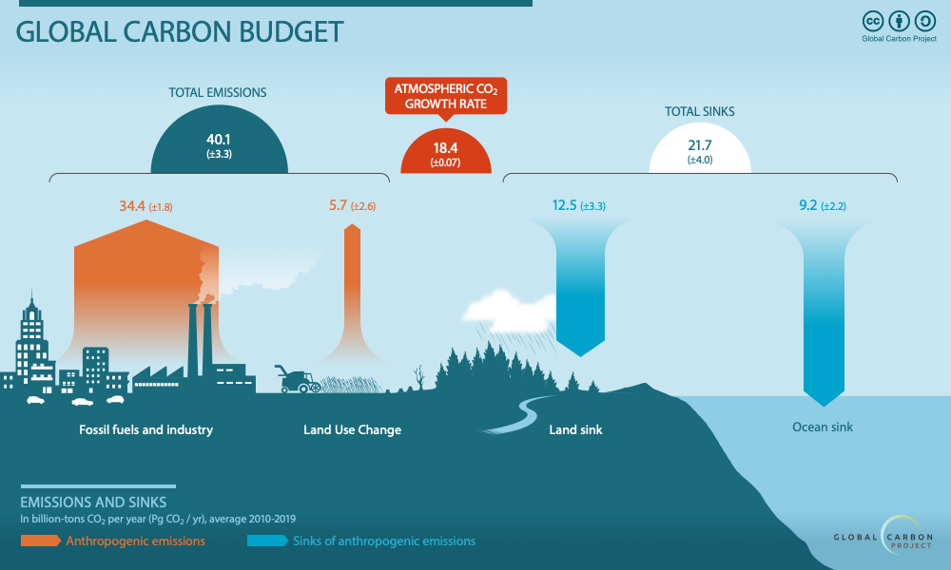
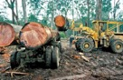
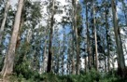
How well do we understand the CO2 fluxes ?
(Graphic by the Global Carbon Project)
Top level global budget is well understood
Fossil fuel: Some uncertainty (~5%), especially for developing countries
Land use: Very large uncertainty (~45%)
Natural sinks: large uncertainties (~25%); subject to climate feedbacks

Slide 28
What information do we need?
We need estimates of forest biomass (AGB), height and disturbances.
The crucial information need is in the tropics
deforestation (~95% of the Land Use Change flux)
regrowth (~50% of the global biomass sink)
Where we have least information and knowledge.
Biomass measurements are needed where the changes occur and at the effective scale of change: hectare scale.
A biomass accuracy of 20% at the hectare scale, comparable to ground-based observations.
Measurements are needed wall-to-wall with repeated measurements over multiple years to identify deforestation and regrowth.
Notes:
To meet the objectives of the mission there are several measurement requirements.
-The mission must resolve the tropical biomass question and so be capable of monitoring these high biomass stands.
-The appropriate resolution is 4 ha, a scale at which ground data are reliable and available, and the key scale of landscape heterogeneity.
-The accuracy must be 20% for biomass, comparable to field observations.
-Height must also be measured as a further constraint – field data show height is correlated with biomass.
-Deforestation detection, at finer scales than the biomass product, will provide further information for understanding biomass change.
-The mission must run for multiple years to identify dynamic processes, and provide the spatio-temporal information that will support the science and decision makers. Sustained, long-term observations of the ongoing perturbation of the carbon cycle by direct human intervention are essential.

Slide 29
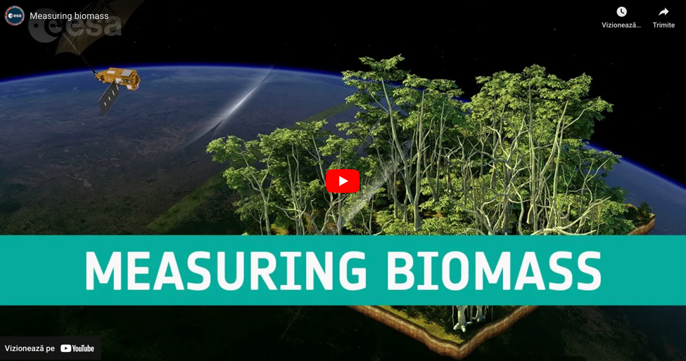
Biomass mission video
https://youtu.be/yYnVTNOBlvc

Slide 30
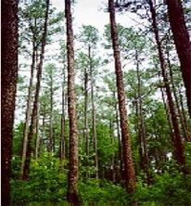
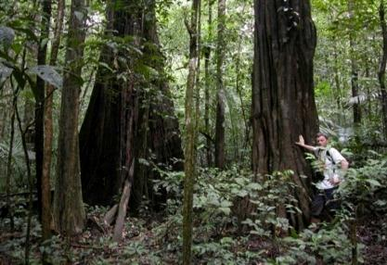
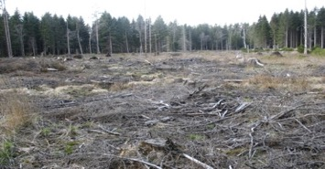
Biomass Products
Forest
height
Forest biomass
Disturbances
Above-ground biomass
(tons/hectare)
Upper canopy height (meter)
Areas of forest clearing (hectare)
200 m resolution
accuracy of 20%, or 10 t ha–1 for biomass < 50 t ha–1
200 m resolution
accuracy of 20-30%
50 m resolution
90% classification accuracy
1 map every 9 months of all forested areas (excl. SOTR region)

Slide 31
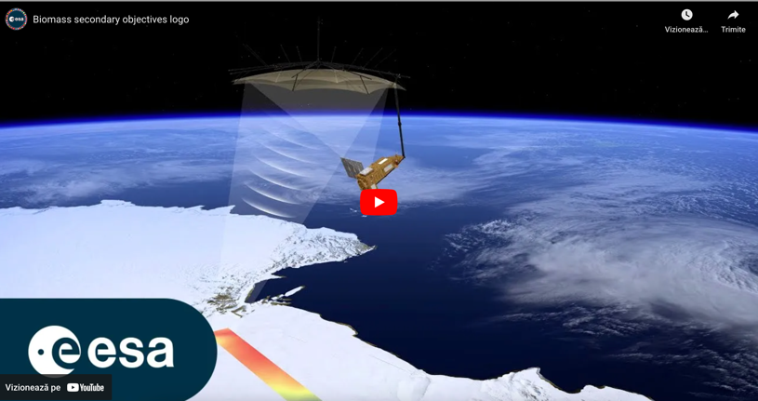
Biomass beyond forests
https://youtu.be/vF8PA6CAll4

Slide 32
Become a contributor to EO Dashboard

Slide 33
Who and how?
Anyone can be a contributor, but mostly researchers and developers
As a researcher, if your research uses data from JAXA, NASA and ESA (especially in combination), you can:
Receive access to cloud computing infrastructure (e.g. sponsored by ESA via Network of Resources)
Propose new content for the dashboard based on your research. This can mean:
Have your datasets included in the catalogue
Have a story published
Have your notebooks/code hosted on a platform and featured in a story
As a developer → contribute to the open-source project (details by Lubo)
As a citizen, provide feedback via the feedback form or Github

Slide 34
Data Access - ESA

Slide 35
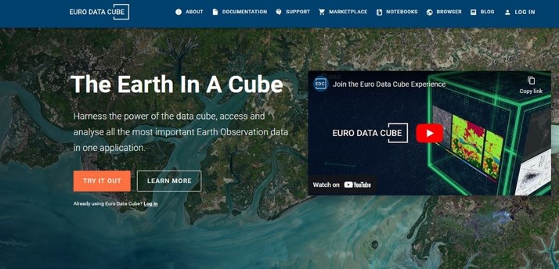
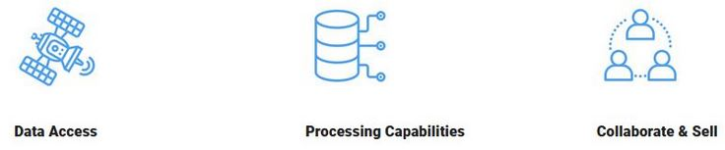
DATA ACCESS
Euro Data Cube
Cloud computing platform offering:
Access to EO archives from open missions (e.g. Sentinel, Landsat, MODIS, etc.), commercial satellites (PlanetScope, Pleiades, SPOT, WorldView, etc.) as well as Level 3 products (Copernicus Land Monitoring Services, C3S, etc.)
Analyse, compare and correlate EO data through Xcube and operational tools (Sentinel Hub)
Manage different data formats and type in a transparent way (raster, vector, COGs, Zarr, csv, etc.)
Bring and store your own data and algorithm for real-time and batch processing operations
Computational resources and storage to run Jupyter Notebooks and your deployed Applications within your Kubernetes-powered workspace
Expose your apps on the EDC marketplace to third-parties and provide easy access to your managed API service to customers

Slide 36
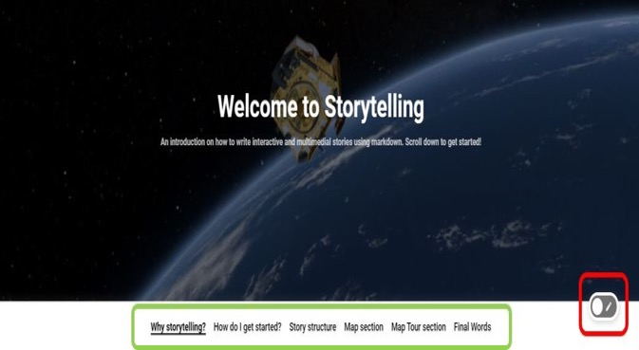
STORYTELLING
Contributions to the EO Dashboard can be made in multiple ways: data, indicators, jupyter notebooks, and stories related to a specific theme.
Storytelling is crucial in science since scientific data can be often complex and challenging to communicate.
Map embedding in your story
Select indicator
Navigate the map
Embed the map
Copy-paste map configuration
Map embedding options
Simple Map adding static visualization (zoom level and extent included) via ‘copy as simple map’
Map Tour Section creating a map tour guiding the user into different map visualizations via ‘copy as map tour section’
Export your story
Function to save and share the file with ESA to trigger ‘publishing acceptance’ procedure
Storytelling editor creating a story based on markdown language
Video Tutorial: http://eox-gtif-public.s3.eu-central-1.amazonaws.com/videos/story_map_export_example.webm

Slide 37
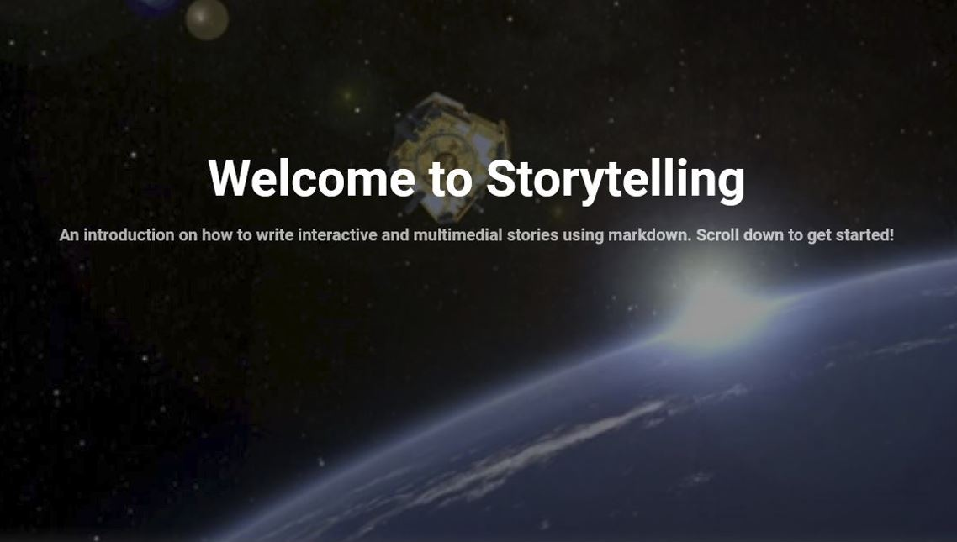
STORYTELLING
Additional resources
Storytelling editor user guide
Storytelling documents/APIs
Markdown
Video tutorial

Slide 38
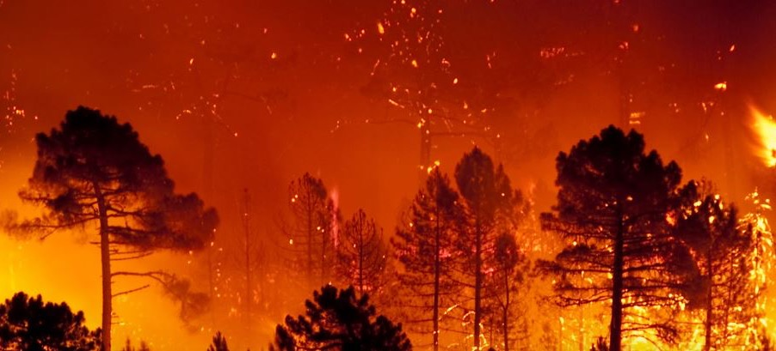
STORYTELLING Wildfires impact
Notes:
https://www.eodashboard.org/story?id=australian-bushfires

Slide 39
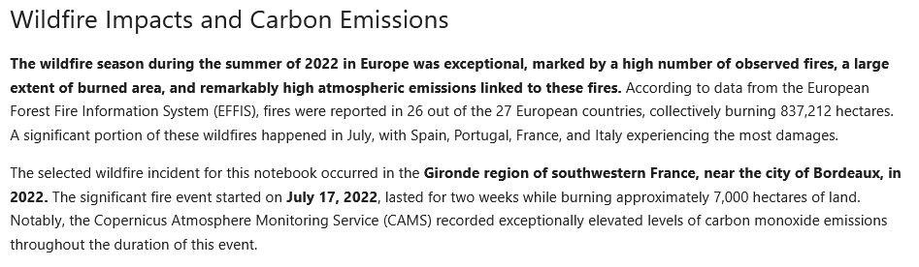
STORYTELLING Evaluation of fire impact on a European site
Additional resources
Storytelling editor user guide
Storytelling documents/APIs
Markdown
Video tutorial
Related articles
Wildfire France - ESA
EU 2022 wildfire season - EU ScienceHub
Forest fires report – European Forest Fire Information System
Summer wildfire emissions - Copernicus Atmosphere Monitoring Service

Slide 40
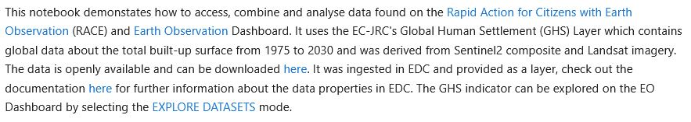
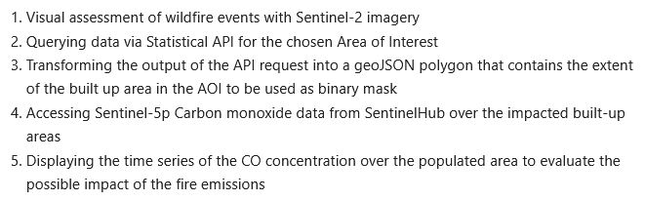
STORYTELLING Evaluation of fire impact on a European site
Additional resources
Storytelling editor user guide
Storytelling documents/APIs
Markdown
Video tutorial
Additional resources
RACE
EO dashboard
GHS dataset
Explore dataset

Slide 41
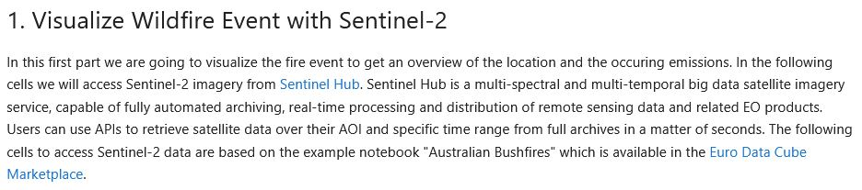
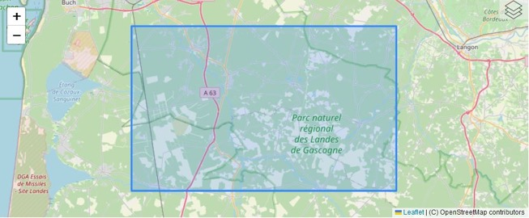
STORYTELLING Evaluation of fire impact on a European site
Additional resources
Sentinel Hub
Market place - EDC

Slide 42
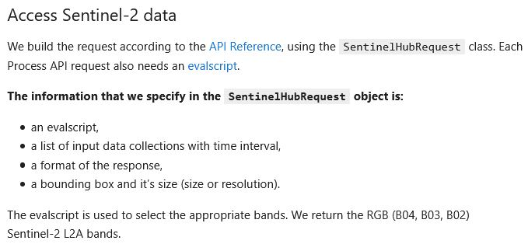
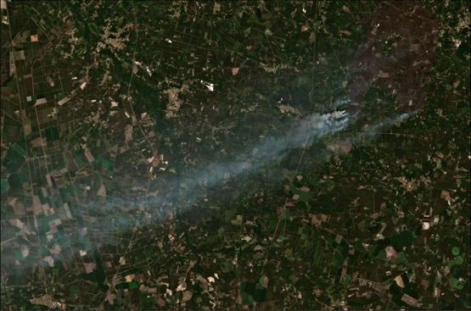
STORYTELLING Evaluation of fire impact on a European site
Additional resources
API reference
Evalscript

Slide 43

STORYTELLING Evaluation of fire impact on a European site
Additional resources
Statistical API

Slide 44
Notebook
The following section references a Jupyter Notebook available on the Euro Data Cube.To execute the Notebook you need a valid subscription to the Euro Data Cube.
Notebook: https://bids2023-nbviewer.hub.eox.at/localfile/bids2023/notebooks/Fire_impact_analysis.ipynb
Options for subscriptions:
30 days free trial: https://eurodatacube.com/
- Sponsored access by ESA from the Network of Resources (NoR):
- learn about the NoR https://nor-discover.org/en/portfolio/
- ask for sponsorship: https://portfolio.nor-discover.org/?textSearch=edc&filterServiceType=Any&filterSource=Any&filterGeographicalCoverage=Any&filterTemporalPeriodStart=&filterTemporalPeriodEnd=

Slide 45

STORYTELLING Evaluation of fire impact on a European site

Slide 46

STORYTELLING Evaluation of fire impact on a European site

Slide 47


STORYTELLING Evaluation of fire impact on a European site
Additional resources
Wildfire story – EO dashboard

